Slide 1
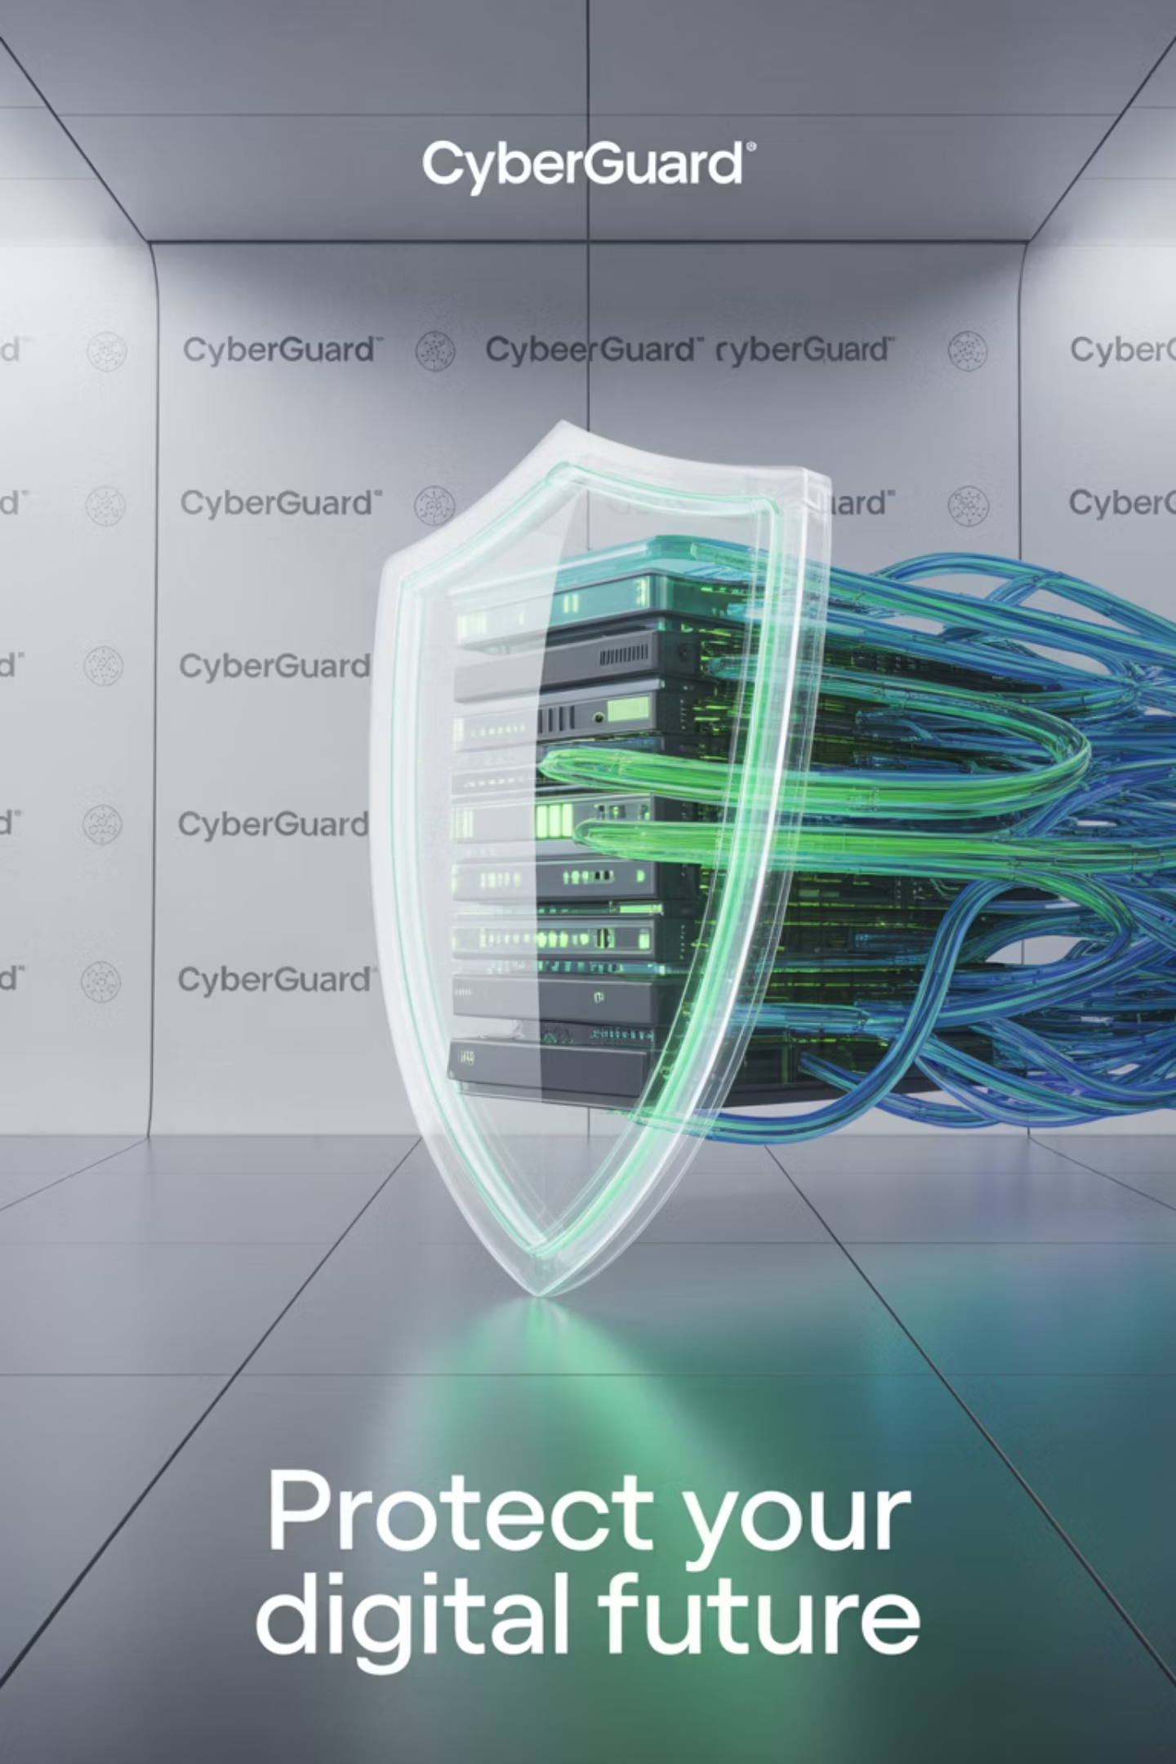
Cybersecurity and Data Breaches
Protecting Data in the Digital Era
Anicet Hermann Zie, CIS311 – Technical Writing in CIS,
Dr. Matthew Zullo
09/21/2025
Notes:
Good morning. My presentation is about cybersecurity and data breaches. I will explain what a data breach is, why it happens, its impacts, and how organizations can prevent it. My goal is to make this clear for both technical and non-technical audiences

Slide 2
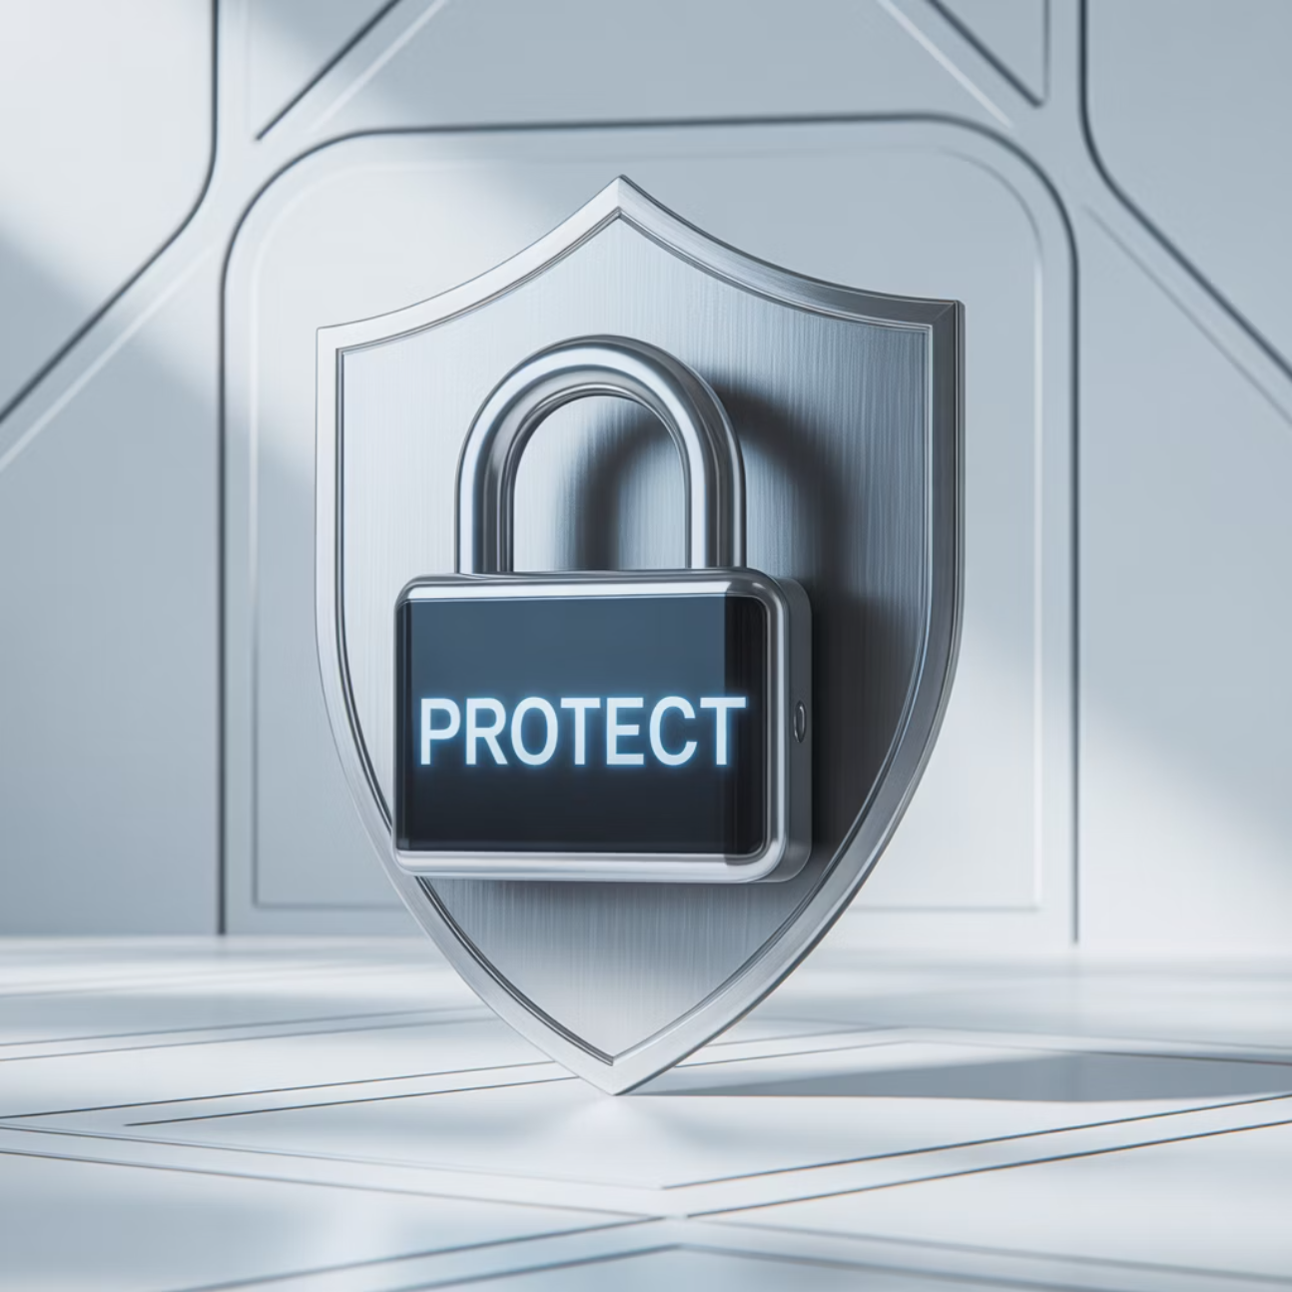
What is a Data Breach?
Unauthorized access to sensitive data.
Examples: customer information, financial records, intellectual property.
Causes: hackers, insider threats, accidents.
Notes:
A data breach happens when unauthorized individuals gain access to confidential data. This can include customer records, financial details, or company secrets. Breaches are not always caused by hackers sometimes they happen by accident or due to insider misuse

Slide 3
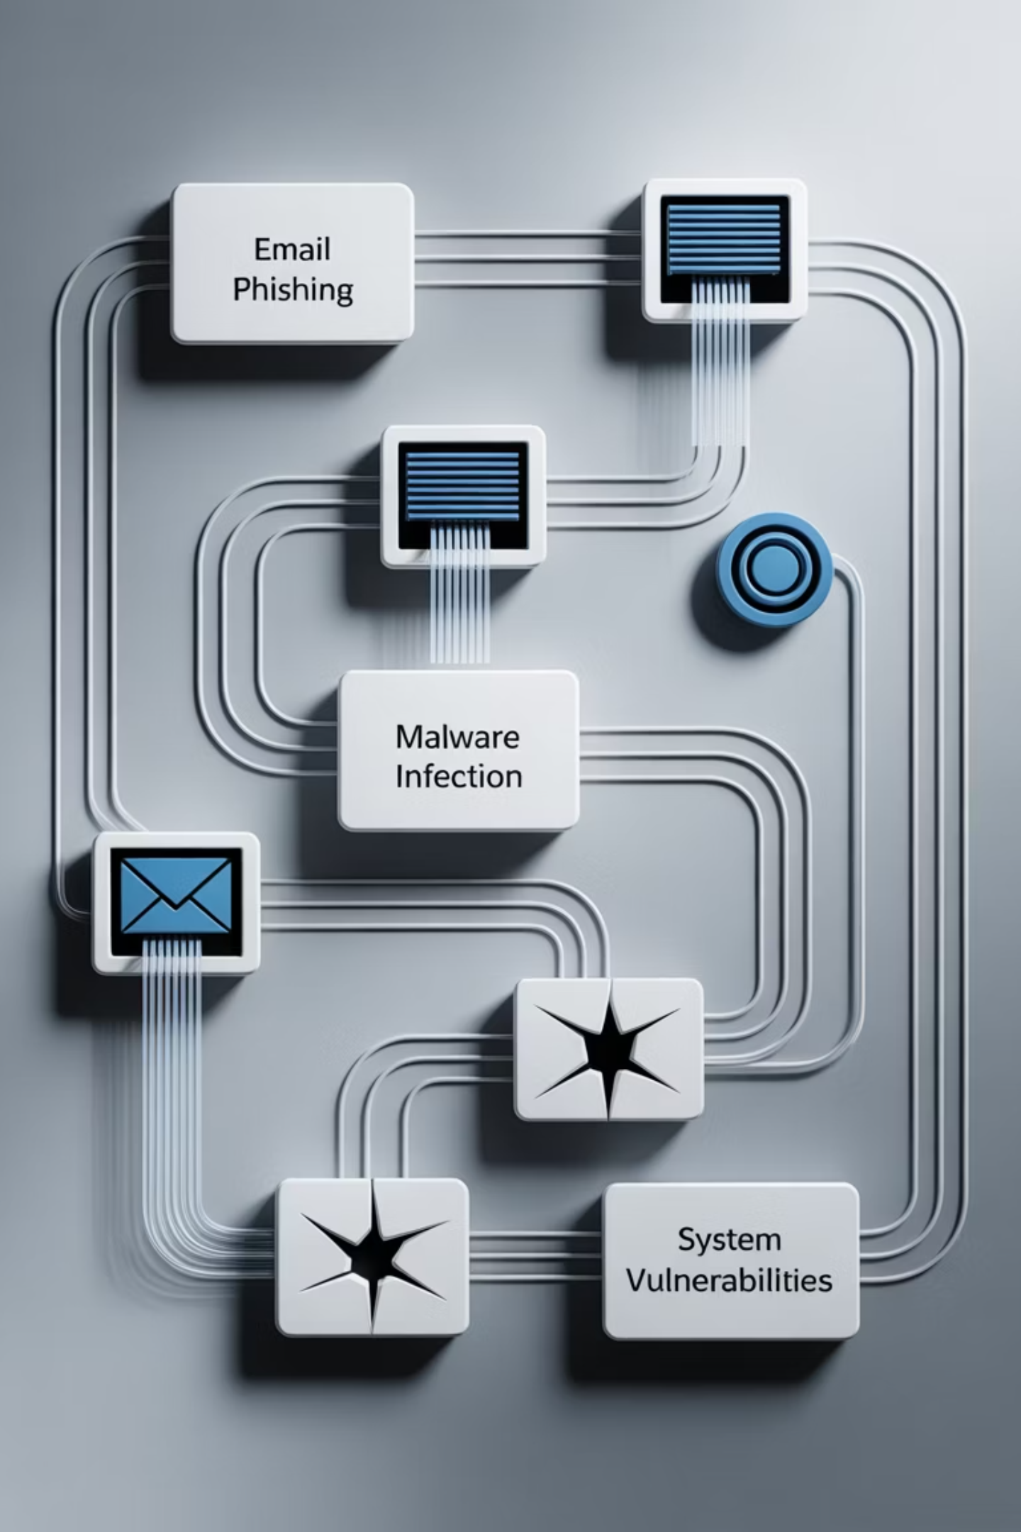
Causes of Data Breaches
Cyberattacks
Human Error
phishing, malware,
ransomware
weak passwords, system misconfiguration
Outdated Systems
unpatched software and systems
Notes:
Data breaches occur for several reasons. Hackers often use phishing emails or ransomware, but human mistakes are just as dangerous. Weak passwords or outdated systems can open the door to attackers.

Slide 4



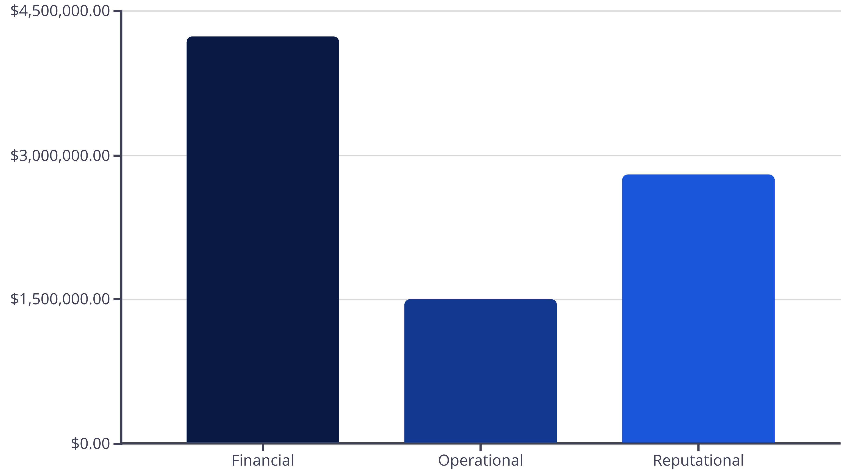
Impacts of Data Breaches
Financial Loss
Reputational Damage
Operational Disruption
lawsuits, fines, recovery costs
loss of trust
downtime, lost productivity
Notes:
The impacts of a data breach are serious. Businesses lose money due to fines and lawsuits. They also suffer reputational damage because customers lose trust. In addition, daily operations may be disrupted for days or weeks.

Slide 5
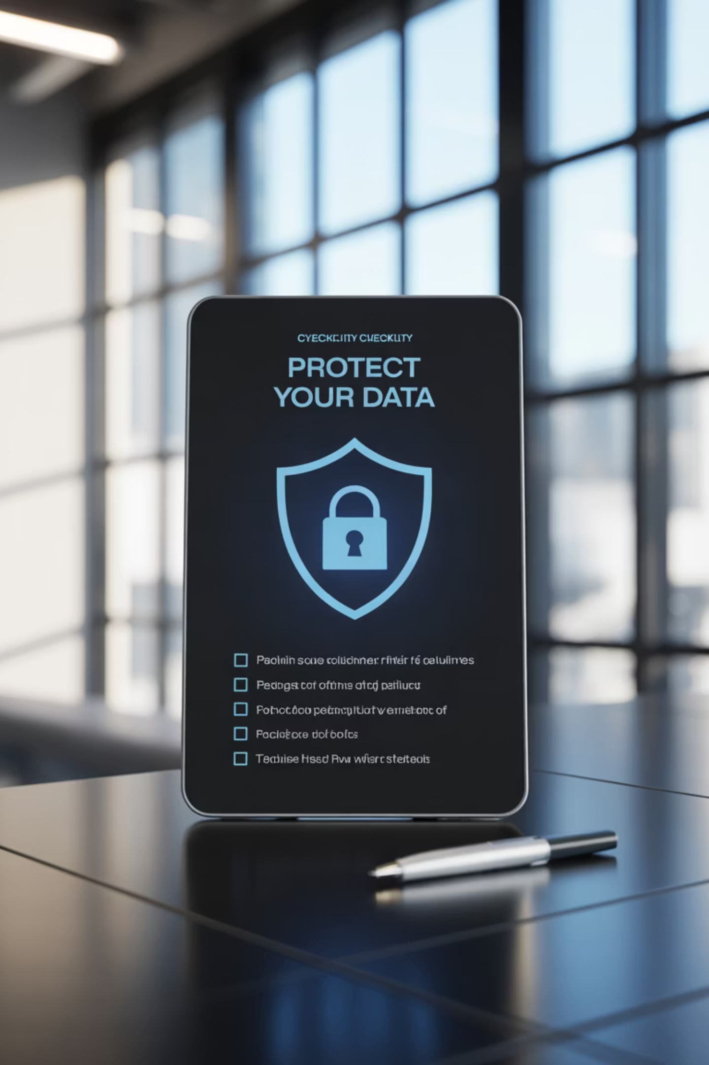
Preventing Data Breaches
01
Strong Authentication
Strong passwords and multi-factor authentication.
02
System Updates
Regular software updates and patches.
03
Employee Training
Employee training about phishing and cyber hygiene.
04
Response Planning
Incident response planning.
Notes:
To prevent breaches, organizations must use strong passwords and multi-factor authentication. They should keep software updated and train employees on cybersecurity. Finally, every company should have an incident response plan to act quickly if a breach happens

Slide 6
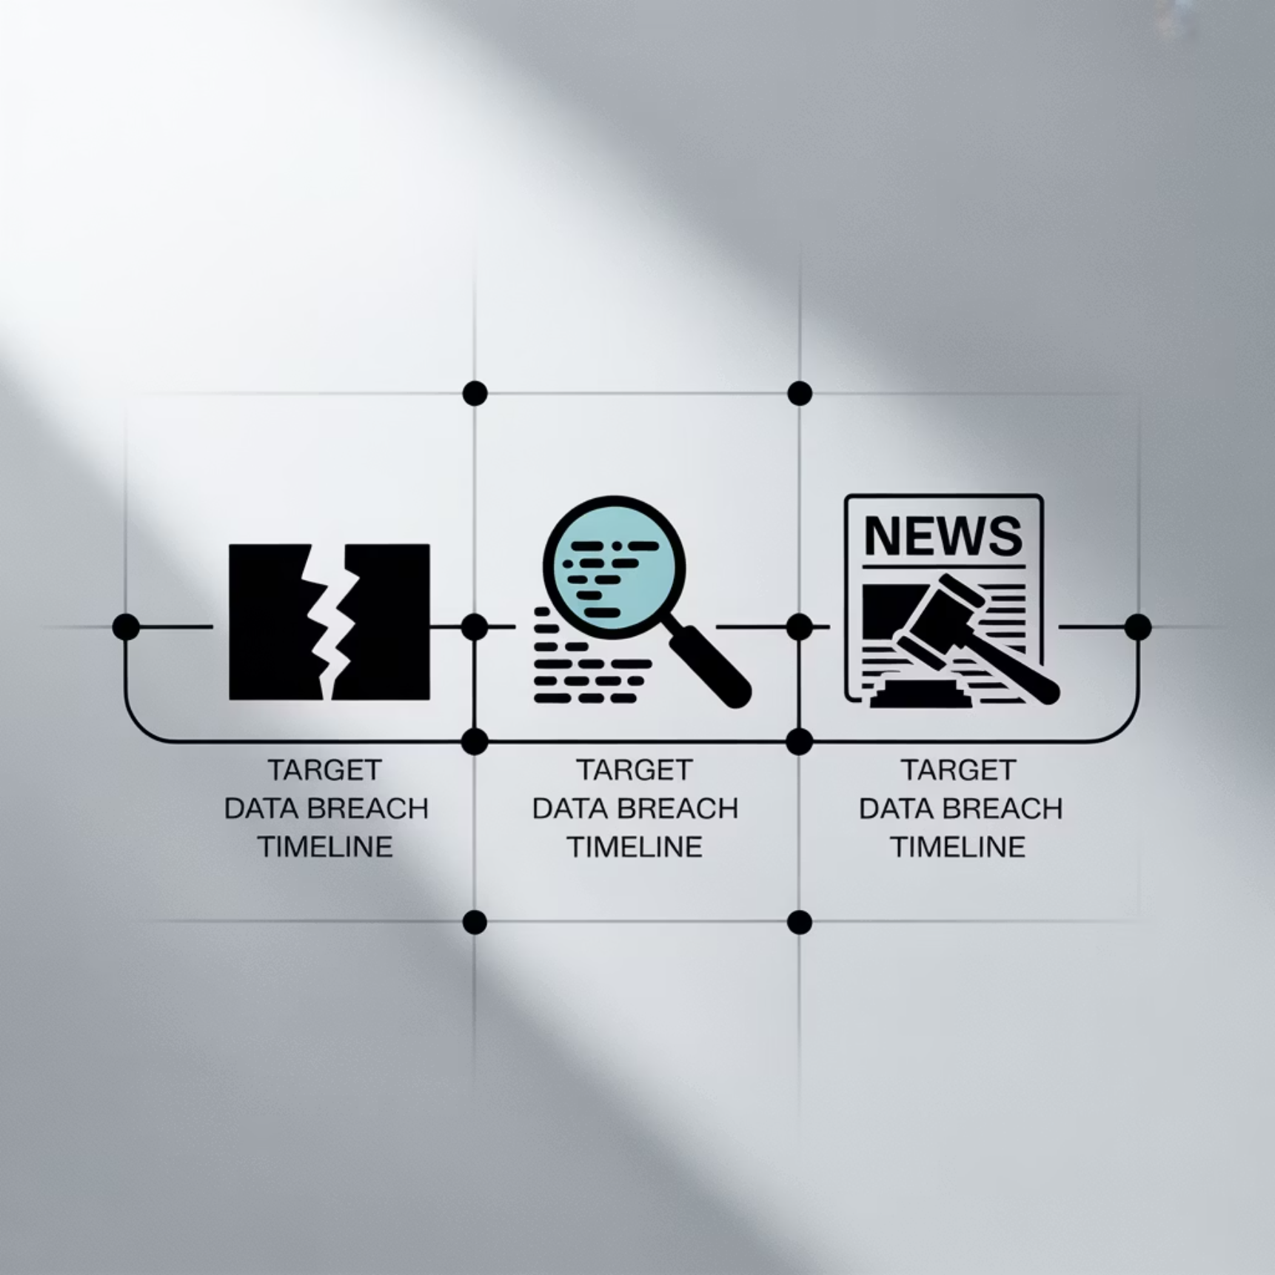
Case Study – Target Breach (2013)
The Breach
40M+ customer records stolen.
Entry point: weak third-party vendor credentials.
Cost: over $200 million.
Lesson: Vendor security is critical.
Notes:
A well-known case is the Target data breach in 2013. Hackers entered through a vendor’s credentials and stole over 40 million customer records. This cost Target over $200 million. The key lesson is that companies must secure not only their own systems but also their vendors.

Slide 7
Key Takeaways
Growing Threat
Multiple Causes
Breaches are a growing threat.
Causes: cyberattacks, human error, outdated systems.
Serious Impacts
Prevention Strategy
Impacts: financial, reputational, operational.
Prevention: layered security, employee training, response planning.
Notes:
In conclusion, data breaches are one of the biggest threats in cybersecurity. They are caused by cyberattacks, human mistakes, and weak systems. The impacts include financial loss, reputational damage, and operational downtime. With strong prevention, training, and planning, organizations can reduce the risks.

Slide 8
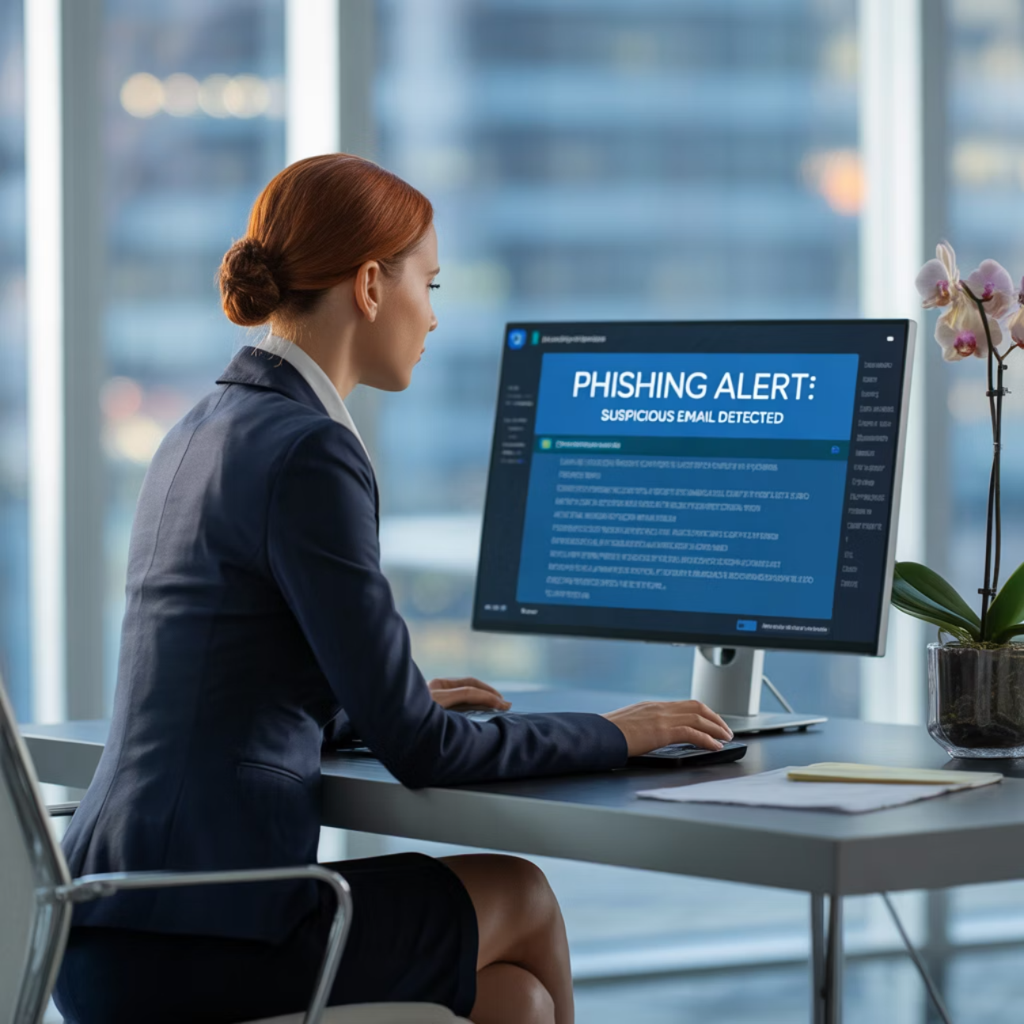
The Human Factor
Why Human Error Matters
Human error accounts for a significant portion of data breaches. Employees may inadvertently click on malicious links, use weak passwords, or misconfigure security settings.
Training and awareness programs are essential to reduce these risks and create a security-conscious culture within organizations.
Notes:
“Human error is one of the biggest contributors to data breaches. Employees might click on a phishing email, use weak passwords, or misconfigure a system without realizing the risk. That’s why training and awareness programs are critical. By teaching staff how to recognize threats and follow security best practices, organizations can greatly reduce these risks and build a culture of cybersecurity awareness

Slide 9



Emerging Threats
Cloud Vulnerabilities
Mobile Device Risks
AI-Powered Attacks
Misconfigured cloud services and inadequate access controls
BYOD policies and unsecured mobile applications
Sophisticated phishing and automated vulnerability exploitation
As technology evolves, so do the methods cybercriminals use to breach systems. Organizations must stay vigilant and adapt their security strategies to address these emerging threats.
Notes:
Cybersecurity threats continue to evolve as technology advances. Cloud vulnerabilities often arise when services are misconfigured or access controls are weak. Mobile device risks have also grown, especially with bring-your-own-device policies and unprotected apps. Finally, AI-powered attacks are becoming more common, with cybercriminals using automation and advanced phishing techniques. Organizations must stay vigilant and update their security strategies to keep pace with these emerging threats.

Slide 10
References
Castillo, M. (2021, July 28). Data breach costs rise to $4.24 million, highest in 17 years. CNBC News. https://www.cnbc.com/2021/07/28/ibm-report-data-breach-costs-rise-to-4point24-million-highest-in-17-years.html
IBM Security. (2023). Cost of a data breach report 2023. https://www.ibm.com/reports/data-breach
National Institute of Standards and Technology. (2018). Framework for improving critical infrastructure cybersecurity. https://doi.org/10.6028/NIST.CSWP.04162018

